Slide 1
Data Communications

Slide 2
DIGITAL DATA, ANALOG SIGNALS
Digital information changes the carrier signal by modifying one or more of its characteristics (amplitude, frequency, or phase).
Modulation techniques :
Amplitude shift keying (ASK)
Frequency shift keying (FSK)
Phase shift keying (PSK)
Quadrature Amplitude Modulation (QAM)
.

Slide 3

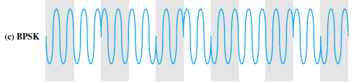
Phase Shift Keying
Two-Level PSK : Uses two phases to represent the two binary digits and is known as binary phase shift keying.
.

Slide 4
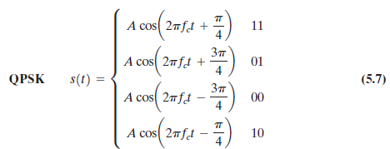
Phase Shift Keying
Four-Level PSK
More efficient use of bandwidth can be achieved if each signaling element represents more than one bit.
Quadrature phase shift keying (QPSK), uses phase shifts separated by multiples of
Each signal element represents two bits rather than one.
.

Slide 5
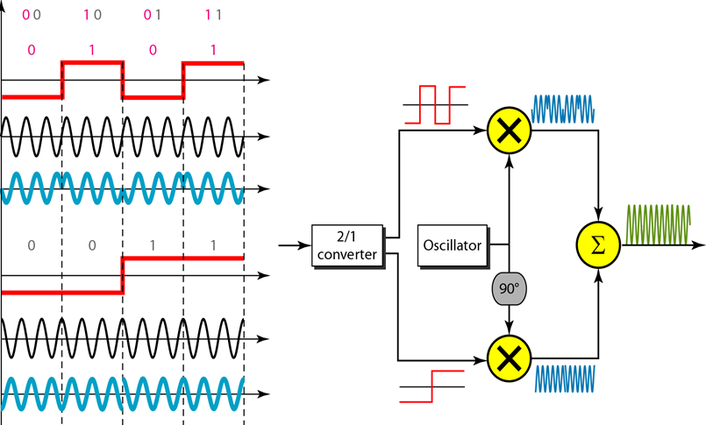
Four-Level PSK
.

Slide 6
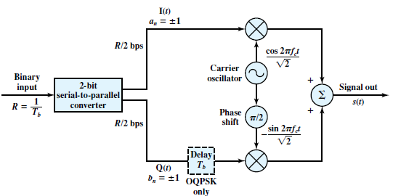

Four-Level PSK
Figure 5.11 QPSK and OQPSK Modulators
.

Slide 7
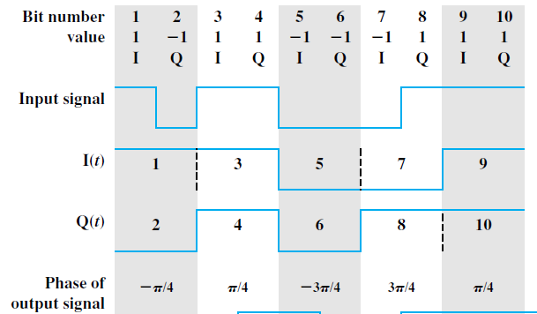
Four-Level PSK
.

Slide 8

offset QPSK (OQPSK) or Orthogonal QPSK
Figure 5.11 QPSK and OQPSK Modulators
.

Slide 9
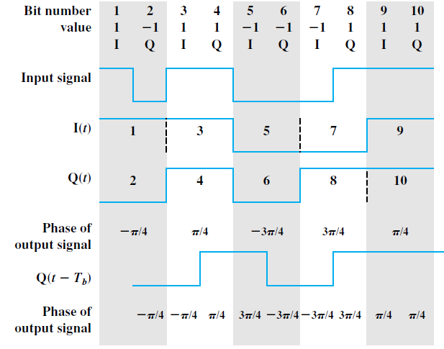
Four-Level PSK
.

Slide 10



Performance
The transmission bandwidth
r depends on modulation and filtering process.
0<= r <=1
R is bit rate
Above is valid for PSK and FSK
M is number of different signal element.
L is number of bits
.

Slide 11
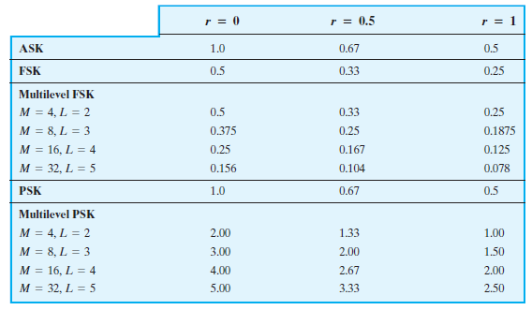
Performance
Table Bandwidth Efficiency for Various Digital-to-Analog Encoding Schemes
.

Slide 12
Quadrature Amplitude Modulation
PSK is limited by the ability of the equipment to distinguish small differences in phase.
This factor limits its potential bit rate.
By combining ASK and PSK it is possible to obtain higher data rate.
is a combination of ASK and PSK.
.

Slide 13
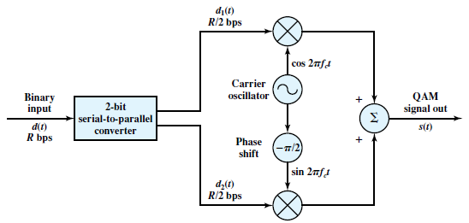
Quadrature Amplitude Modulation
.

Slide 14
Communication media
.

Slide 15
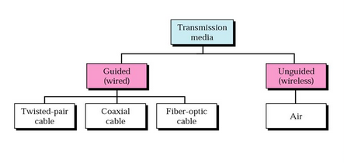
Communication media : path between transmitter and receiver in a data communication system.
.

Slide 16
Quality of transmission
Quality of data transmission are determined by media and signal characteristics.
For Guided media, the medium is more important in determining the limitations of the transmission.
ie bandwidth, signal to noise ratio, attenuation.
For unguided media, the bandwidth of the signal produced by the transmission antenna is more important than the medium.
ie antenna will play a key role.
.

Slide 17
Design factors
Bandwidth
Transmission impairments
Interference
particular concern for unguided media and guided media.
For guided media, interference can be caused by emanations from nearby cables.
Number of receivers
A guided medium can be used to construct a point to-point link or a shared link with multiple attachments.
In the latter case, each attachment introduces some attenuation and distortion on the line, limiting distance and/or data rate.
.

Slide 18
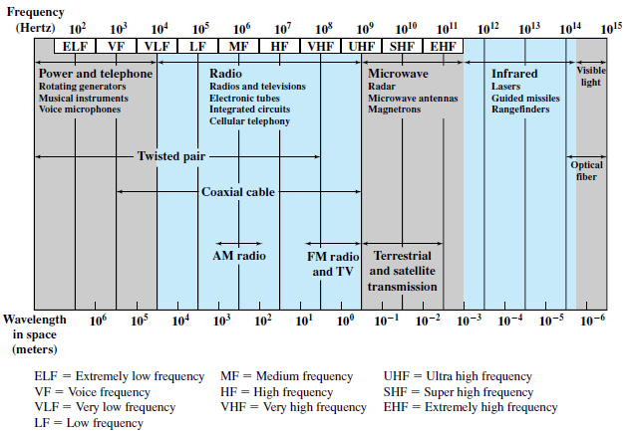
electromagnetic spectrum and indicates the frequencies at which various guided media and unguided transmission techniques operate.
.

Slide 19
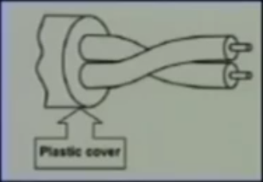
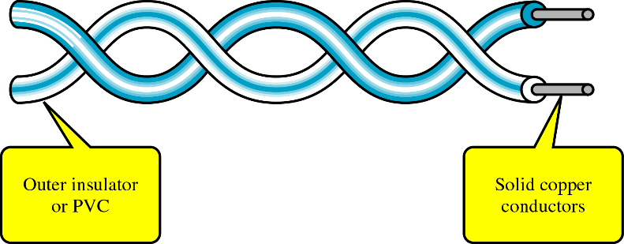
Twisted pair
Consists of two insulated copper wires arranged in a regular spiral pattern.
Polyvinyl chloride
.

Slide 20
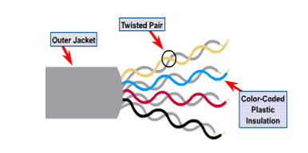
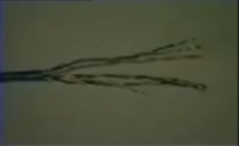
Twisted pair
Typically, a number of pairs are bundled together into a cable by wrapping them in a tough protective sheath.
.

Slide 21
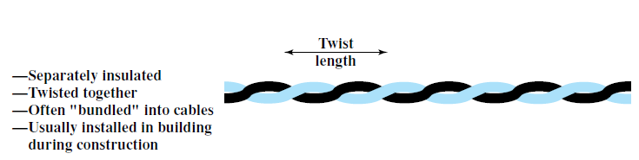
Why twisting
Signal passing in one pair of wire may induce signal on another pair of wire.
Twisting decreases the cross talk interference between adjacent pairs in a cable.
Tighter twisting produce much better performance, but also increases the cost.
.

Slide 22
Applications
Simplest and cheapest guided media used in many application.
Local loop in telephone lines.
Local area network
.

Slide 23
Transmission Characteristics
used to transmit both analog and digital transmission.
For analog signals, amplifiers are required about every 5 to 6 km.
For digital transmission (using either analog or digital signals), repeaters are required every 2 or 3 km.
.

Slide 24
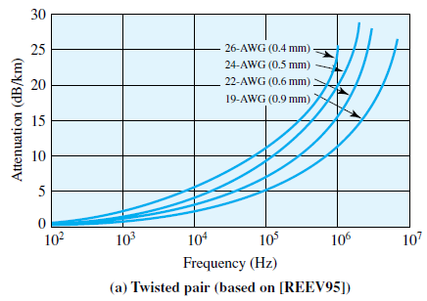
Transmission Characteristics
is limited in distance, bandwidth, and data rate compare to other media.
the attenuation for twisted pair is a very strong function of frequency.
America Wire Guage (AWG)
.

Slide 25
Attenuation characteristics of UTP
Observation
As diameter of the conductor increases the attenuation decreases.
Higher the frequency, attenuation also increases.
As length increases attenuation is also increases.
Note : diameter α cost.
Attenuation α (distance) ²
.

Slide 26
Twisted Pair common types
Unshielded twisted pair(UTP)
Shielded twisted pair(STP)
.

Slide 27
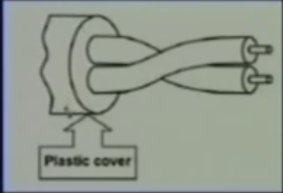
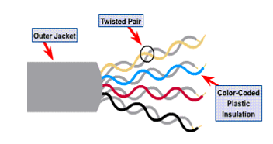
Unshielded Twisted Pair (UTP)
Ordinary telephone lines
Subject to electromagnetic interfernce. (spark, lightening)
.

Slide 28
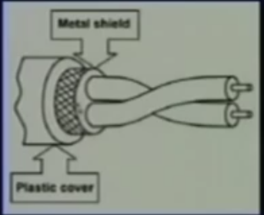
Shielded Twisted Pair (STP)
Has a metal foil or braided mesh covering that encases each pair of insulated conductor.
Expensive compare to UTP
.

Slide 29
Shielded Twisted Pair (STP)
3 different configurations
Foil twisted pair (FTP) : Each pair of wire is individually shielded with metallic foil.
Screened twisted pair (F/UTP) : There is a foil or braid shield inside the jacket covering all wires.
Fully shielded twisted pair or shielded/foil twisted pair (S/FTP) : There is a shield around each individual pair, as well as around the entire group of wires.
.

Slide 30
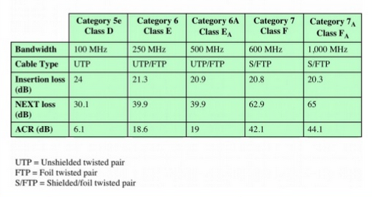
categories of twisted pair
.

Slide 31
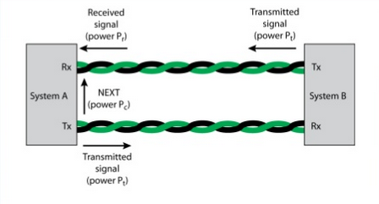
Insertion loss : amount of attenuation across the link from transmitting system to the receiving system.
Near-end crosstalk (NEXT) loss : is the coupling of the signal from one pair of conductors to another pair.
.

Slide 32


Insertion loss : amount of attenuation across the link from transmitting system to the receiving system.
Near-end crosstalk (NEXT) loss : is the coupling of the signal from one pair of conductors to another pair.
Amount of signal loss between the local transmitter and local receiver.
.

Slide 33


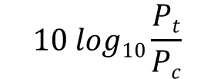

Attenuation-to-crosstalk ratio (ACR)
Is a measure of how much larger the received signal strength is compared to the cross talk on the same wire
A positive value required for successful operation.
We want
P_{r} > P_{c is the desired condition}
.

